Slide 1
Root-Down Exposure for Maximal Clique Enumeration on GPUs
PPoPP 2026
Zhe Pan, Peng Qu, Youhui Zhang
https://craft.cs.tsinghua.edu.cn/
Tsinghua University

Slide 2

Outline
Introduction
Problem definition
Baseline MCE solutions
Challenges
Load imbalance
Memory pressure
RDMCE: Root-Down MCE solution
Root-down exposure
Bitmap-centric MCE scheme
Aggressive node generation
Evaluation

Slide 3
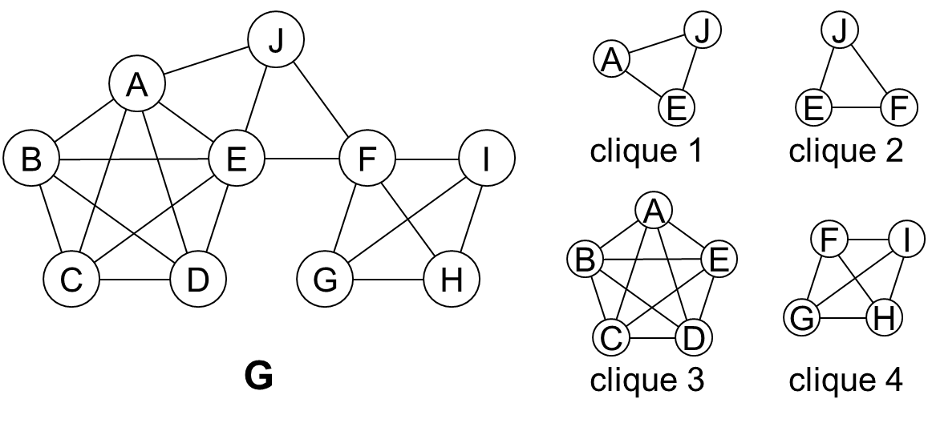
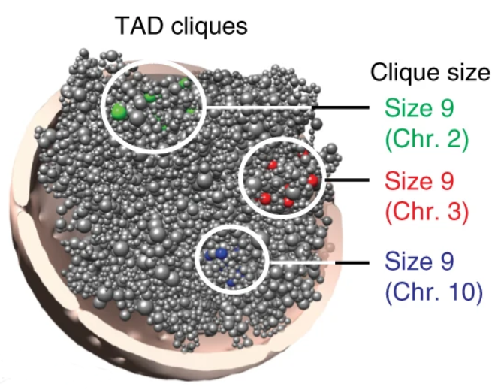
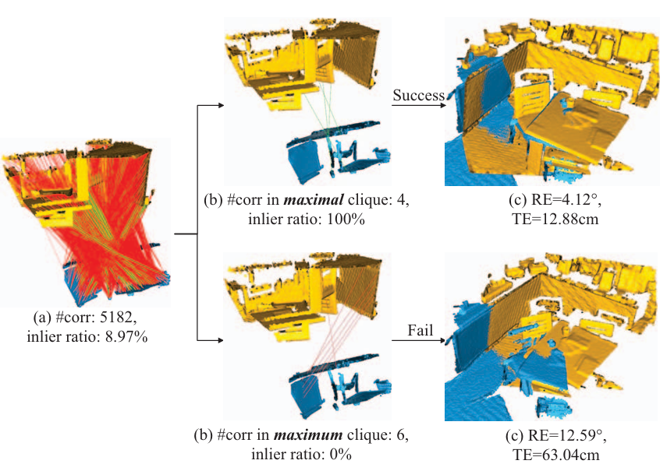
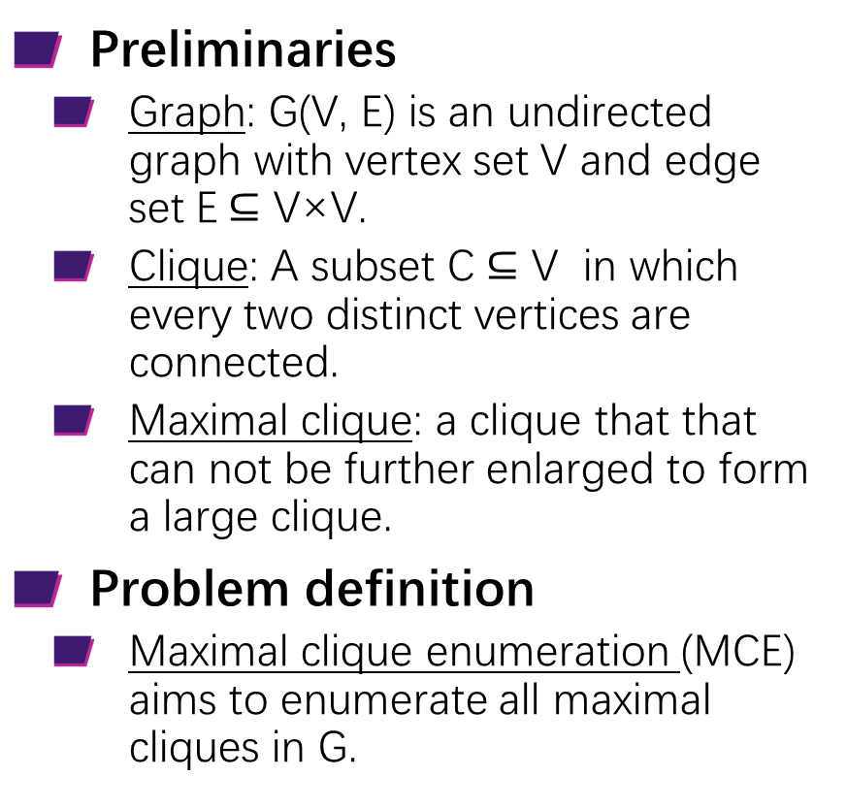
Introduction: Problem Definition
Preliminaries
Graph: G(V, E) is an undirected graph with vertex set V and edge set E$⊆$ V×V.
Clique: A subset C $⊆$ V in which every two distinct vertices are connected.
Maximal clique: a clique that that can not be further enlarged to form a large clique.
Problem definition
Maximal clique enumeration (MCE) aims to enumerate all maximal cliques in G.
A graph G containing 4 maximal cliques.
Application 1:Genome 3D map: TAD cliques as maximal clusters¹.
Application 2:Low-overlap point-cloud registration via maximal cliques².
Paulsen et al., Long-range interactions between topologically associating domains shape the four-dimensional genome during differentiation, Nature Genetics, 2019.
Yang et al., MAC: Maximal Cliques for 3D Registration, IEEE Transactions on Pattern Analysis and Machine Intelligence, 2024.

Slide 4
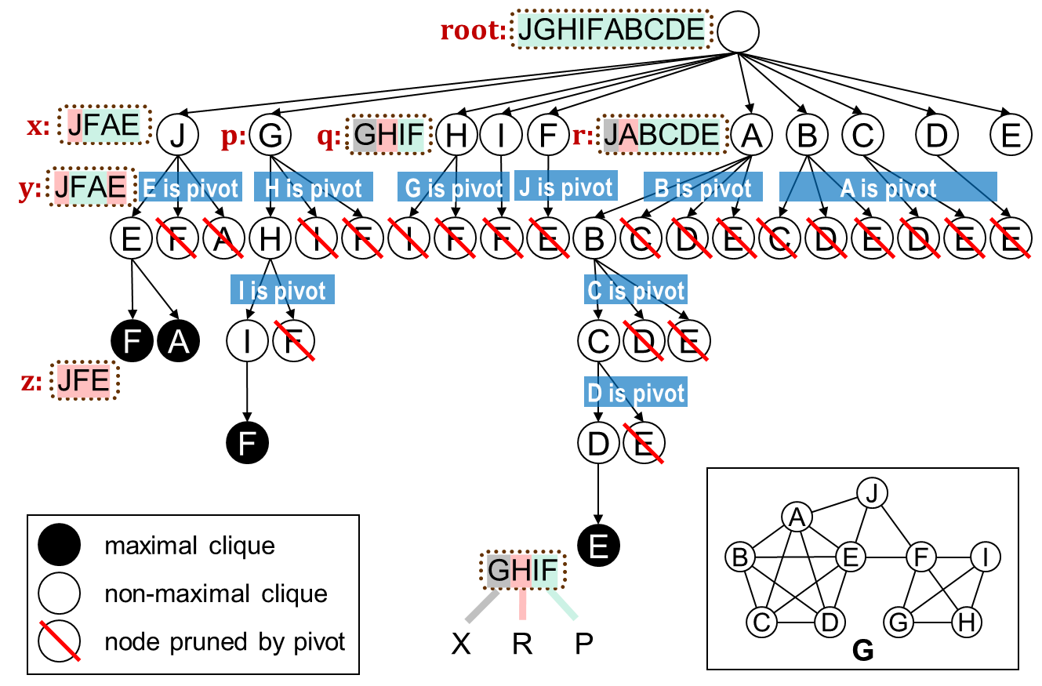
Introduction: Baseline MCE Solutions
Bron–Kerbosch (BK) Framework
Search recursively using three sets: R (clique), P (candidates), X (excluded)
Pivoting reduces branching
Degeneracy ordering bounds depth
Parallelizing MCE on GPUs
Advantage: GPU's massive parallelism enables high throughput → GPU solutions significantly outperform CPU baselines
Bottleneck: Unbalanced search trees cause severe load imbalance → significant synchronization overhead from busy workers pausing to share work
Search tree of BK with pivoting and degeneracy ordering on graph G

Slide 5
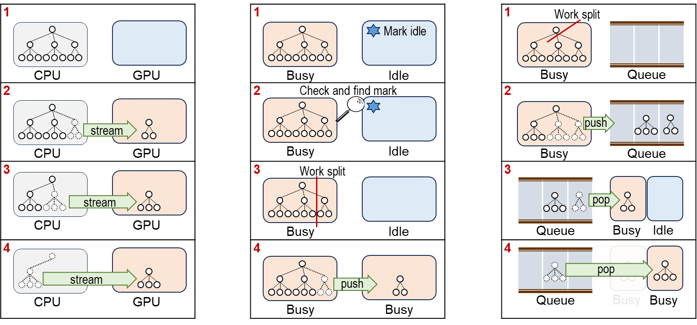
Introduction: Baseline MCE Solutions
Load Balancing Strategies for GPU Graph Mining
Host-Driven Chunking
(GBK, G²-AIMD)
Peer-to-Pear Handoff
(mce-gpu, STMatch)
Global Queue
(GMBE, GMBE+)
BFS
DFS
DFS
CPU partitions graph and streams induced subgraphs.
Busy GPU workers pause, split works, and hand off to idle peers.
Workers push/pull tasks from a shared queue.

Slide 6
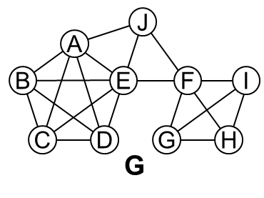
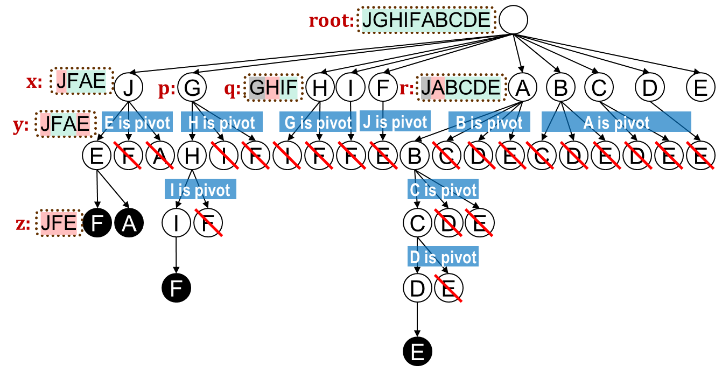
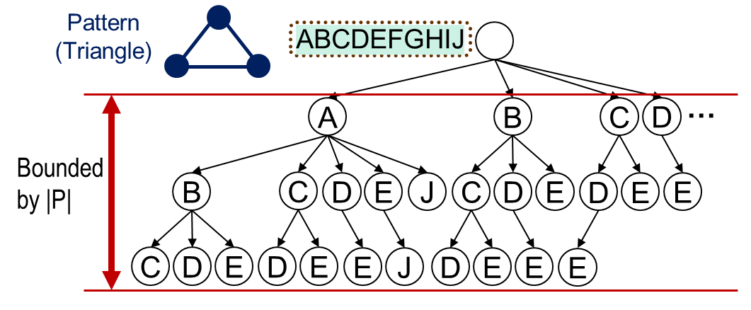
Introduction: Challenges
Graph Analytics (e.g., BFS, SSSP)
Workload scales with |V| — each vertex maps to one task, resulting in uniform task granularity.
Maximal Clique Enumeration
Search depth equals maximal clique size (can reach hundreds), with branching factor varying dynamically — creating extreme depth and irregularity.
Resulting Challenges for GPU Parallelization:
Severe load imbalance — highly irregular subtrees
Memory pressure — deep recursion and large intermediate states
Graph Pattern Mining
Search tree depth is bounded by pattern size |P| (typically <10), limiting depth variability.

Slide 7
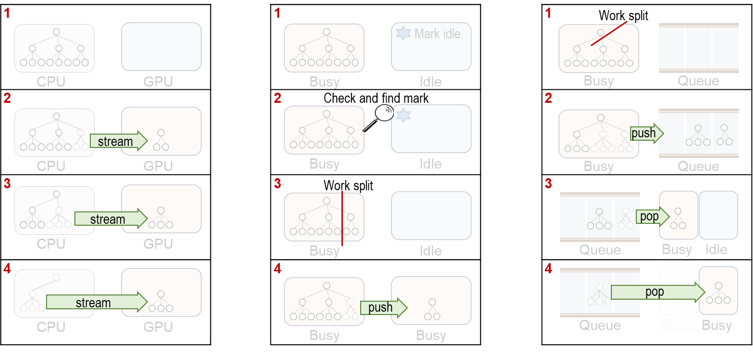
Challenge 1: Load Imbalance
Host-Driven Chunking
(GBK, G²-AIMD)
Peer-to-Pear Handoff
(mce-gpu, STMatch)
Global Queue
(GMBE, GMBE+)
Memory copy
Repeat data transfer
Force busy workers shoulder the balancing cost.
Work split
Synchronization

Slide 8
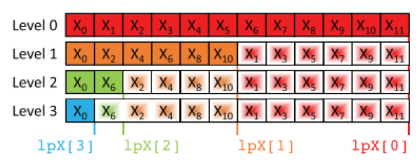
Challenge 2: Memory Pressure
Dynamic memory allocations on GPUs are expensive
We need to execute multiple MCE procedures in parallel
Task Queue
Buffer for memory copy
Pre-allocate memory on GPUs before enumeration
Requires multiple blocks of memory
…
Compact representation of X¹
Exceeds the memory capacity
SOTAs use numerous auxiliary GPU memory blocks
Almasri et al, Parallelizing Maximal Clique Enumeration on GPUs, Proceedings of International Conference on Parallel Architectures and Compilation Techniques (PACT)., 2023.

Slide 9
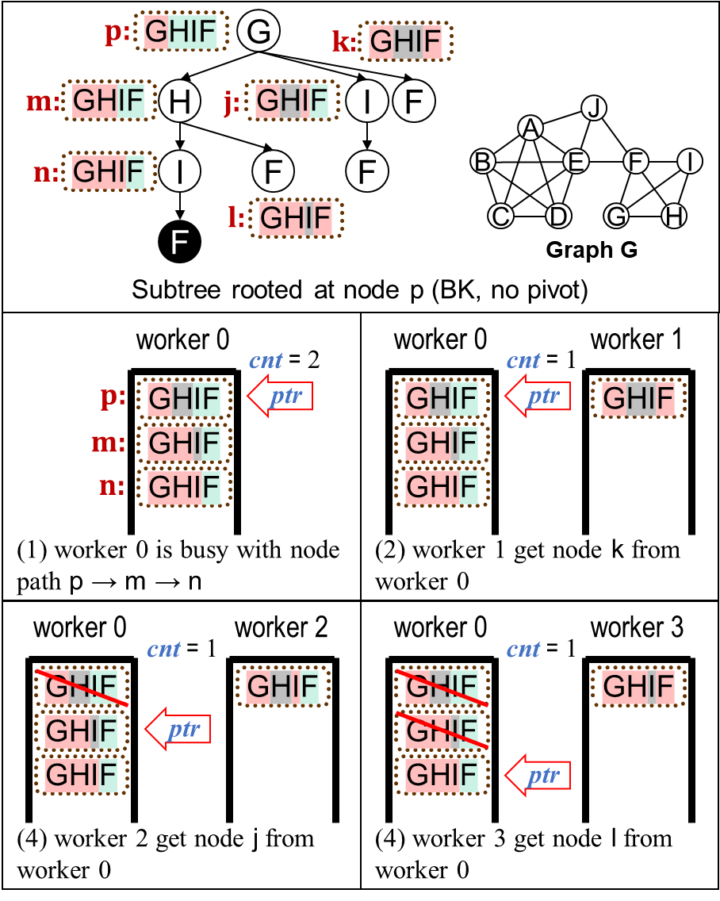
RDMCE: Root-down Exposure
Design principle
Expose work, don't transfer it — let idle workers pull tasks without interrupting busy ones.
Details
Each worker adds:
ptr → pointer to exposed root node
cnt → remaining candidate count at that node
Idle side: Workers atomically fetch candidates
Busy side: When cnt reaches 0, move ptr deeper in DFS stack; continue enumeration uninterrupted
Takeaway: Exposing a reference to the workload rather than transferring the workload itself.

Slide 10
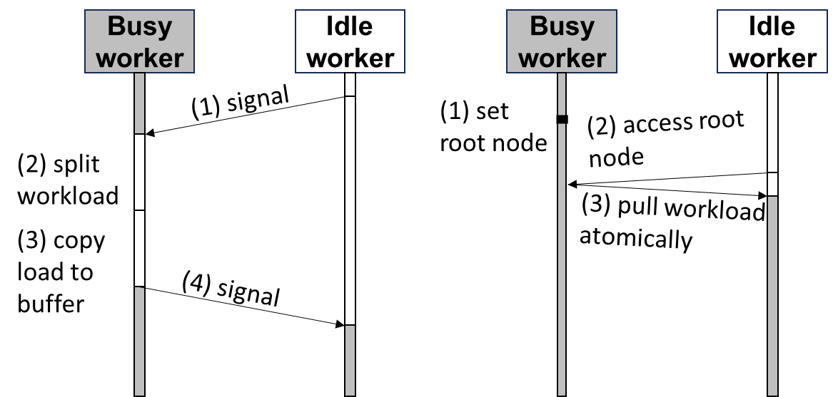
RDMCE: Root-down Exposure
Benefits
Eliminates synchronization overhead (no pausing)
Removes extra memory buffers (no copying)
Chooses most promising nodes for splitting (root has largest P)
Takeaway: Exposing a reference to the workload rather than transferring the workload itself.

Slide 11
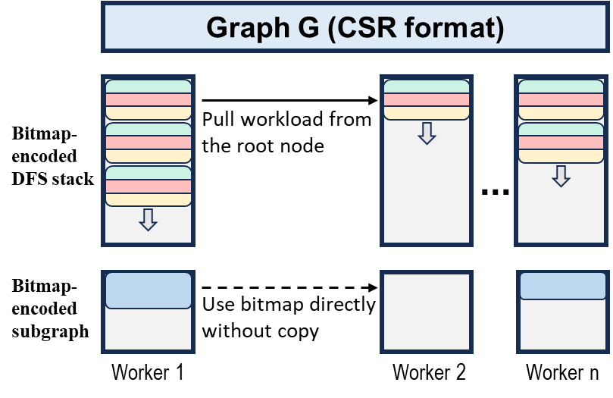
RDMCE: Bitmap-Centric MCE Scheme
Design principle
Simplify memory layout and accelerate computation through bitmap encoding.
Memory layout
Global graph: Compact CSR format
Per-worker subgraph: Bitmap encoded
DFS stack: Bitmap triples (R, P, VP)
Details
Encode subgraph once per worker into bitmaps
Idle workers directly reuse busy workers' bitmaps
No extra data movement during load balancing
Benefits
Zero-copy sharing eliminates memory overhead while preserving fast bitwise computation.

Slide 12
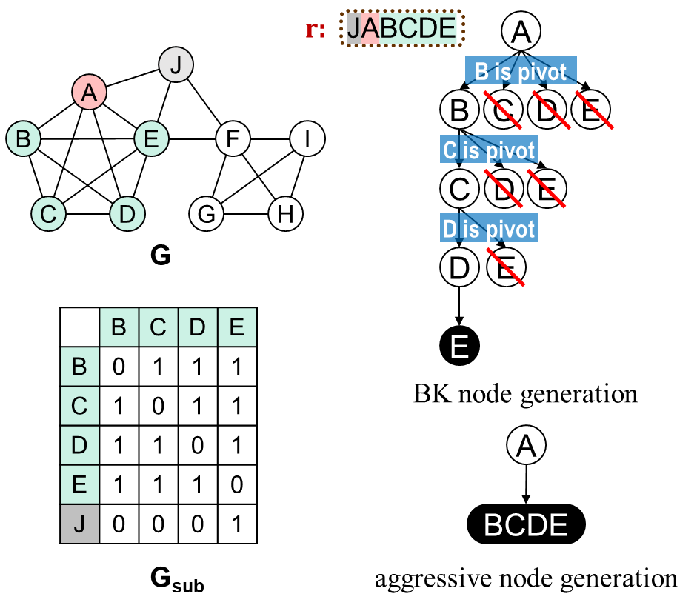
RDMCE: Aggressive Node Generation
Design Principle
Add multiple vertices at once — skip intermediate nodes when possible.
Observation
Vertices connected to all other candidates belong to every maximal clique in the branch.
Details
Batch add vertices that connect to all other candidates — skip one-by-one expansion.
Benefits
Eliminates intermediate nodes → accelerates traversal with minimal added computation.

Slide 13
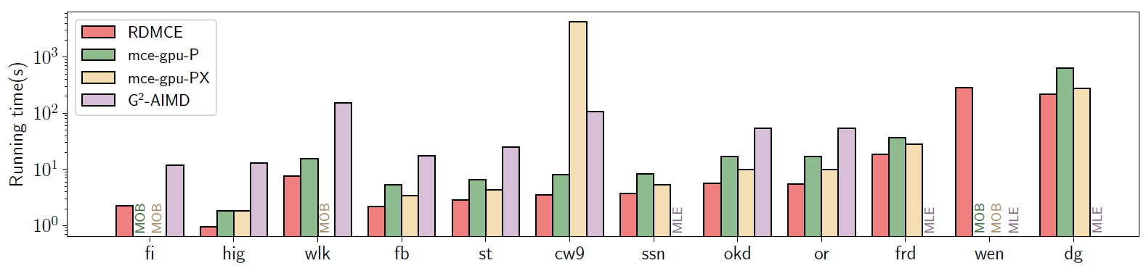
Evaluation: Overall Evaluation
Running time comparison (log scaled)
RDMCE is the only GPU solution that completes all 12 real-world datasets, achieving 1.25–5.38× speedup over the next best.
mce-gpu fails on large graphs due to out-of-bounds memory access (MOB).
G2-AIMD aborts by Memory Limit Exceeded (MLE) due to BFS memory pressure.

Slide 14
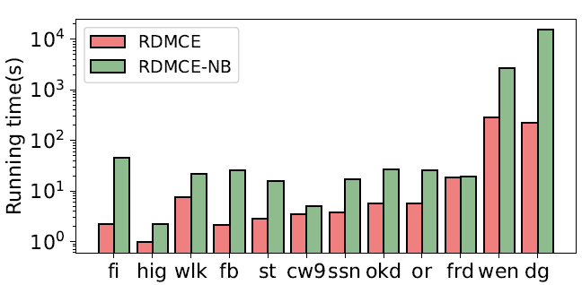
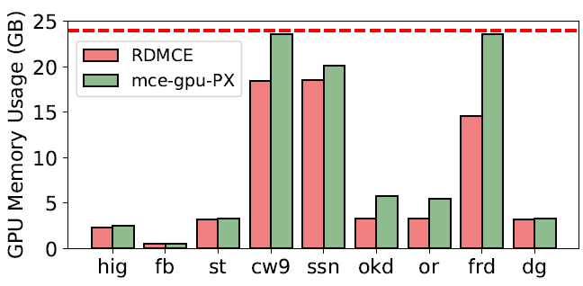
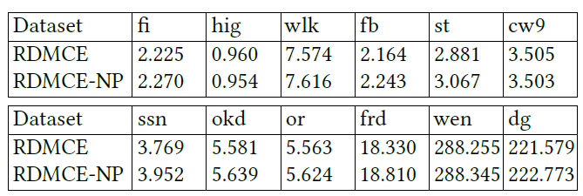
Evaluation: Breakdown Evaluation
Effect of the root-down exposure mechanism (log scale). RDMCE-NB is RDMCE with this mechanism disabled.
Effect of the bitmap-centric MCE scheme. The red line marks the 24 GB capacity of an NVIDIA RTX 4090.
All three proposed techniques contribute effectively
Root-Down Exposure mechanism delivers 69× speedup on Dogster
the Bitmap Scheme uses 20% less memory than mce-gpu
Aggressive Node Generation provides up to 6.4% additional speedup
Effect of aggressive node generation (running time in seconds). RDMCE-NP is RDMCE with the optimization disabled.

Slide 15
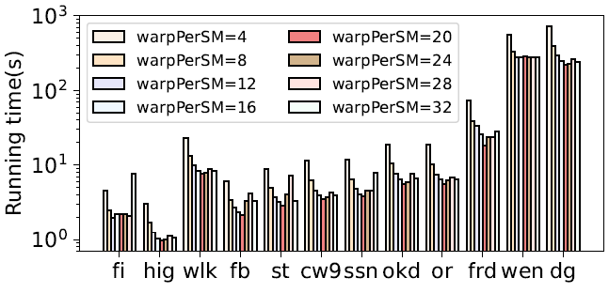
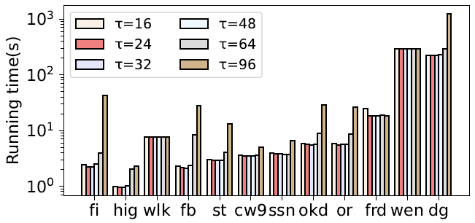
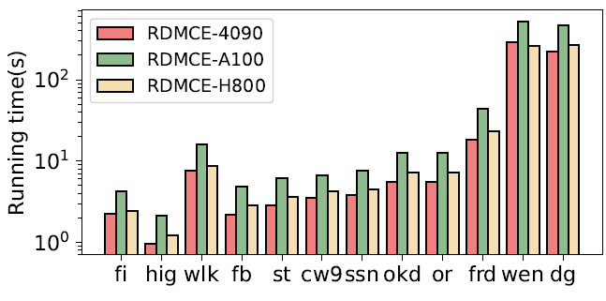
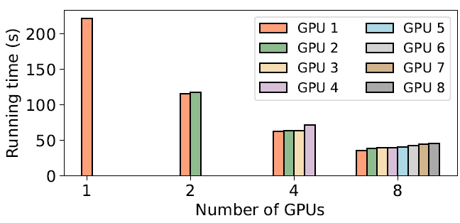
Evaluation: Sensitivity Analysis
Impact of warpPerSM (log scale).
Impact of 𝜏 for root-down exposure (log scale).
Adaptability of RDMCE on different GPUs (log scale).
Scalability of RDMCE on 8× NVIDIA RTX 4090 GPUs using Dogster dataset with 146B maximal cliques.

Slide 16
Thanks
PPoPP 2026
Root-Down Exposure for Maximal Clique Enumeration on GPUs
Open source at: https://github.com/Pz1996/RDMCE
Contact: pz@mail.tsinghua.edu.cn

