Slide 1
Enumeration of Billions of Maximal Bicliques in Bipartite Graphs without Using GPUs
Zhe Pan, Shuibing He, Xu Li, Xuechen Zhang*, Yanlong Yin,
Rui Wang, Lidan Shou, Mingli Song, Xian-He Sun#, Gang Chen
Zhejiang University, *Washington State University Vancouver, #Illinois Institute of Technology
Notes:
(Thank you for great introduction. )
Hello, everyone. Thank you for listening to my talk. My name is Zhe Pan. And I recently graduated from Zhejiang University, where I conducted this research. Today, I’d like to share our work on the maximal biclique enumeration problem, commonly known as MBE problem.

Slide 2
Outline
Introduction
Problem definition
Baseline MBE approach
Graph representation in memory
Motivation
Computational subgraph
Key insights
AdaMBE: Adaptive MBE algorithm
Redesign of key operations using local neighborhood information
Hybrid in-memory representation of computational subgraphs
Evaluation
Notes:
Here is the outline of my presentation. First, I will provide a brief introduction to maximal biclique enumeration problem and the related background information. Then, I will discuss the motivation behind our work. Finally, I will present our high-performance solution and its evaluation.

Slide 3
Introduction
Problem definition
Baseline MBE approach
Graph representation in memory
Notes:
In this section, I will introduce the MBE problem, discuss the baseline MBE approach, and provide some background knowledge on graph representation in memory.

Slide 4
Introduction: Problem Definition
Preliminaries
Bipartite graph $G\left(U,V,E\right)$ : A graph structure contains two disjoint vertex sets $U,V$ and an edge set $E.E⊆U×V$.
Biclique : A complete bipartite graph in which every vertex is connected to every vertex in the opposite subset.
Maximal biclique : a biclique that can not be further enlarged to form a large biclique.
Problem definition
Maximal biclique enumeration (MBE) aims to find all maximal bicliques in $G$.
v₀
v₁
v₂
v₃
u₀
u₁
u₂
u₃
u₄
u₅
u₆
u₇
u₈
u₉
An example of a bipartite graph G₀ and a maximal biclique ({u₀, u₄, u₅, u₆}, {v₀, v₂, v₃}) in G₀.
Notes:
Maximal biclique enumeration is a classical problem in graph computing. To start, imagine a graph where the vertices are split into two sets, U and V, and edges only exist between vertices in different sets. This type of graph is called a bipartite graph. Now, a biclique is simply a subgraph where every vertex in set U is connected to every vertex in set V—essentially, a complete bipartite graph.
A maximal biclique is one that cannot be expanded by adding any more vertices or edges without breaking the complete connection between U and V. The MBE problem involves finding all maximal bicliques in a given bipartite graph. This is important in various applications, such as social network analysis, recommendation systems, and bioinformatics. For example, in e-commerce, a maximal biclique refers to a group of users who all buy the same set of products at the same time. This could be a sign of fake transactions. An example is shown on the right.

Slide 5
Introduction: Baseline MBE Approach
Is it always necessary to use all vertices during the enumeration process?
Set enumeration tree for MBE
Each tree node is a 3-tuple $(L,R,C)$. $\left(L,R\right)$ is the corresponding biclique and $C$ stores candidate vertices for expanding $R$.
Baseline approach
Step 1 : Utilize a set enumeration tree to generate the powerset of $V.$
Step 2 : Expand each subset of the powerset of $V$ to a biclique $(L,R)$ and enumerate maximal ones.
Notes:
The mainstream approach for Maximal Biclique Enumeration (MBE) is based on a set enumeration tree. Each node in the tree is a 3-tuple (L, R, C), where (L, R) represents the corresponding biclique, and C is a candidate set of vertices that could potentially expand R. To be specific, this enumeration tree first generates the power set of V—that is, all possible subsets of V—and assigns each subset to the R set of a node, ensuring no repetitions.
In the example on the right, all R sets are highlighted in blue. Then, each node expands its R set into a unique biclique (L, R), since all R sets are distinct. Finally, all maximal bicliques are enumerated from the tree.
One question: Is it always necessary to use all vertices during the enumeration process?

Slide 6
Introduction: Graph Representation in Memory
v₀ | → | u₀ | u₁ | u₂ | u₄ | u₅ | u₆ | u₇
v₁ | → | u₀ | u₁ | u₂ | u₃
v₂ | → | u₀ | u₁ | u₃ | u₄ | u₅ | u₆ | u₇ | u₈
v₃ | → | u₀ | u₃ | u₄ | u₅ | u₆ | u₈ | u₉
u₀ | u₁ |  |  | u₂ |  | u₅
 | u₇ |  |  |  |  | u₄ | u₆
0 | 1 | 2 | 3 | 4 | 5 | 6 | 7 | 8 | 9
10 | 11 | 12 | 13 | 14 | 15 | 16 | 17 | 18
v₀ | →
v₁ | →
v₂ | →
v₃ | →
Can we combine the advantages of different graph representations?
u₀ | u₁ |  |  | u₂ |  |  |  |  | u₃
0 | 1 | 2 | 3 | 4 | 5 | 6 | 7 | 8 | 9
10 | 11 | 12 | 13 | 14 | 15 | 16 | 17 | 18
Time: $O(Δ(V))$
Space:$O(|E|)$
Adjacency list.
u₀ | u₁ |  |  |  |  | u₅ | u₈ |  | u₃
 | u₇ |  |  |  |  | u₄ | u₆
 | u₀ | u₁ | u₂ | u₃ | u₄ | u₅ | u₆ | u₇ | u₈ | u₉
v₀ | 1 | 1 | 1 | 0 | 1 | 1 | 1 | 1 | 0 | 0
v₁ | 1 | 1 | 1 | 1 | 0 | 0 | 0 | 0 | 0 | 0
v₂ | 1 | 1 | 0 | 1 | 1 | 1 | 1 | 1 | 1 | 0
v₃ | 1 | 0 | 0 | 1 | 1 | 1 | 1 | 0 | 1 | 1
0 | 1 | 2 | 3 | 4 | 5 | 6 | 7 | 8 | 9
10 | 11 | 12 | 13 | 14 | 15 | 16 | 17 | 18
u₀ |  |  |  |  | u₉ | u₅ | u₈ |  | u₃
 |  |  |  |  |  | u₄ | u₆
0 | 1 | 2 | 3 | 4 | 5 | 6 | 7 | 8 | 9
10 | 11 | 12 | 13 | 14 | 15 | 16 | 17 | 18
Time: $O(|U|)$ ($O(1)$ for small graphs)
Space:$O(\left|U\right|×|V|)$
Time: $O(Δ(V))$
Space:$O(|E|)$
(b) Bitmap.
(c) Hash table.
Note: Time is set intersection time, and Space is the graph storage space based on the specific representation.
Notes:
Let’s begin by discussing graph representations in memory, which are crucial to the performance of MBE algorithms. Here, "time" refers to the time complexity for performing set intersections, and "space" refers to the space complexity for storing the entire graph. The adjacency list is the most common representation in modern MBE algorithms due to its low memory usage, but performing set intersections on adjacency lists takes at least O(\Delta(V)) where \Delta(V) is the maximum degree of vertices in V.
Bitmaps are fast for small graphs, performing set intersection in constant time, but they have high memory overhead, especially for sparse graphs. Hash tables speed up set lookups and are useful when input sets differ in size, but they can suffer from higher memory usage and random access latency. This raises another important question: Can we combine the advantages of different graph representations?

Slide 7
Motivation
Computational subgraph
Key insights
Notes:
In this section, we provide the formal definition of computational subgraphs in MBE, analyze its characteristics, and discuss limitations in existing works.

Slide 8
Motivation: Computational Subgraph
Computational subGraph (CG): At the current node (L, R, C), the CG in MBE is the subgraph formed by the vertices in L∪C, along with all edges between L and C in the original bipartite graph.
Example: Given a node x, we highlight the corresponding CG of node x in the original bipartite graph G₀ in blue.
L : u₀ u₁ u₂
R : v₀ v₁
C : v₂ v₃
Node x:
v₀
v₁
v₂
v₃
u₀
u₁
u₂
u₃
u₄
u₅
u₆
u₇
u₈
u₉
Bipartite graph G₀
Notes:
Given an enumeration node with L, R, and C, the computational subgraph is a subgraph consists of all vertices in sets L and C with edges between them. An example is shown on the right. We introduce the concept of CG because we have found that this subgraph is sufficient for the enumeration process. We will detail its usage in the next slide.

Slide 9
Motivation: Key Insights
Characteristics of CGs
The size of CGs dynamically changes. Most of these CGs are relatively small.
The computational subgraph of the current enumeration node can be directly used for node generation.
Existing algorithms require access to vertices outside their corresponding CGs.
Limitations of existing works
They typically operate on the original graph, resulting in extensive access to vertices outside CGs.
They commonly utilize the adjacency list as the default choice for representing graphs.
Distribution of CG sizes based on |L| and |C|.
Percentage of vertices inside and outside CGs on real-world datasets.
Notes:
Here are some key observations about computational CGs. First, we found that most CGs are quite small, with approximately 90% containing fewer than 32 vertices in both the L and C sets. Second, we determined that the CG is sufficient for node generation. we prove it in the paper.
Third, we observed that all existing algorithms require accessing vertices outside the CG, and this external access contributes to over 90% of memory operations in most datasets. These observations highlight two major limitations of current algorithms: （1）they unnecessarily access over 90% vertices outside the CG, and （2）they rely on a single graph representation, which may not be optimal.

Slide 10
AdaMBE: Adaptive MBE Algorithm
Redesign of key operations using local neighborhood information
Hybrid in-memory representation of computational subgraphs
Unnecessary vertex accesses
Single graph representation
Notes:
In this section, we present two approaches to tackle two limitations: reducing unnecessary vertex accesses through a redesigned CG-based operation, and overcoming the limitations of a single graph representation with a hybrid approach. Finally, we implement the AdaMBE algorithm by combining these two approaches.

Slide 11
AdaMBE: Redesign of Key Operations Using Local Neighborhood Information
Unnecessary vertex accesses
Local neighbors
Neighbors of vertex v in the current CG.
Main idea
We use local neighbors to redesign key operations to reduce unnecessary vertex accesses, repetitive set intersections, and unproductive tree nodes at the same time.
Notes:
To reduce massive unnecessary vertex accesses, we redesign key operations using local neighborhood information. At beginning, we define local neighbors as the neighbors of a node within the current CG.

Slide 12
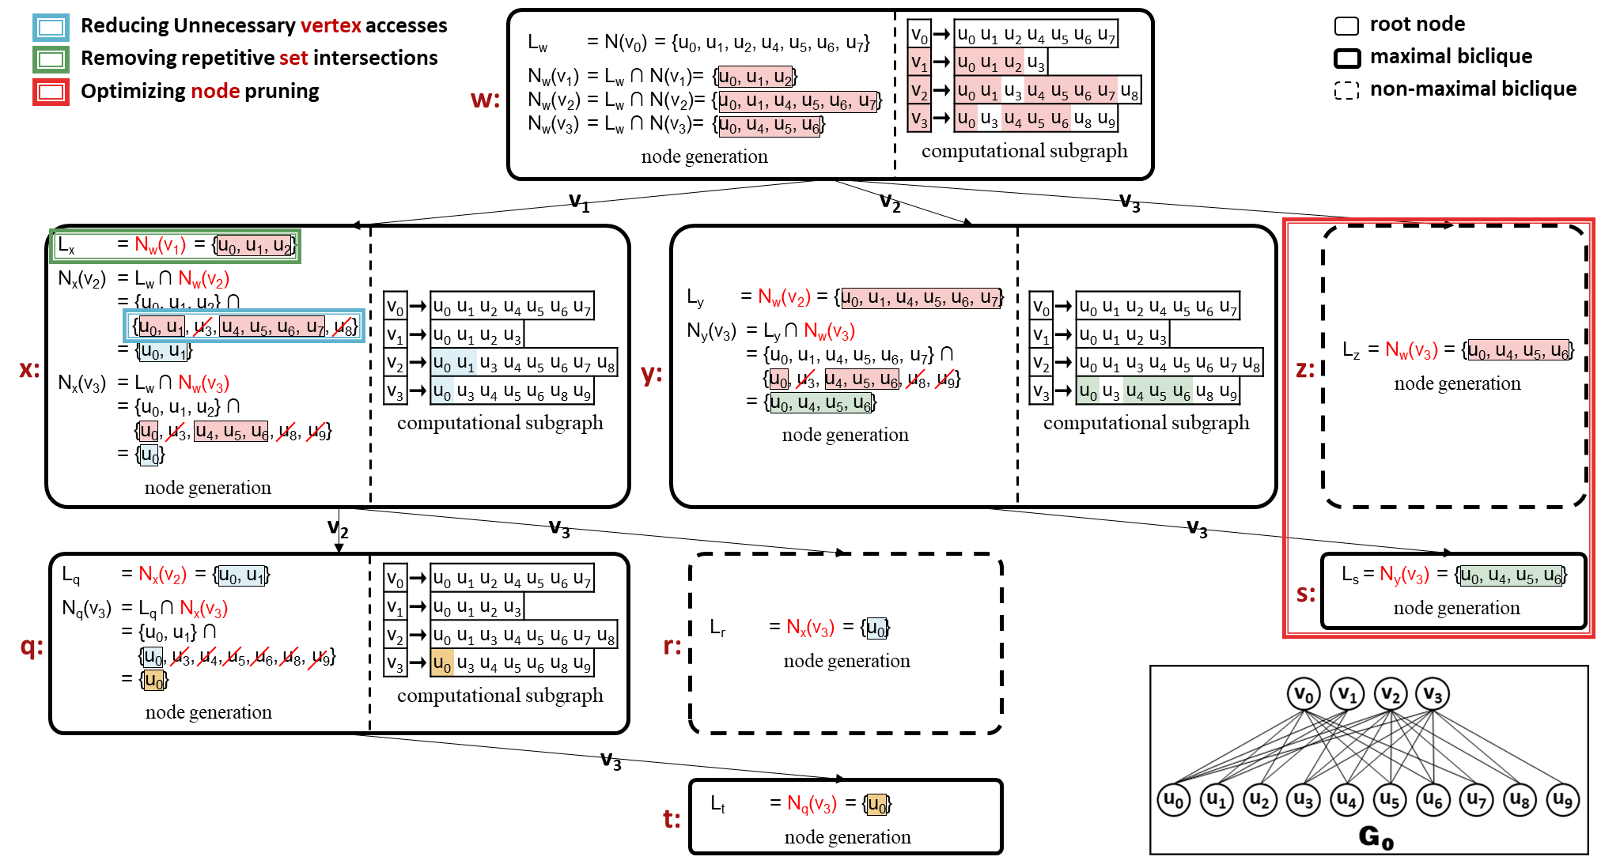
AdaMBE: Redesign of Key Operations Using Local Neighborhood Information
Unnecessary vertex accesses
Local neighbors
Neighbors of vertex v in the current CG.
Main idea
We use local neighbors to redesign key operations to reduce unnecessary vertex accesses, repetitive set intersections, and unproductive tree nodes at the same time.
Notes:
For example, for node w, the local neighbors of v1 are the neighbors of v1 in Lw. In the diagram on the right, we highlight the vertices in the CG in red, representing the local neighbors, which are shown using adjacency lists. By actively maintaining the CG for each node, we can avoid unnecessary accesses to non-highlighted vertices.

Slide 13
AdaMBE: Redesign of Key Operations Using Local Neighborhood Information
Unnecessary vertex accesses
Local neighbors
Neighbors of vertex v in the current CG.
Main idea
We use local neighbors to redesign key operations to reduce unnecessary vertex accesses, repetitive set intersections, and unproductive tree nodes at the same time.
Notes:
Next, we make full use of CGs to simultaneously reduce vertex accesses, set intersections, and tree nodes. This method reduces vertex access since it doesn't require accessing vertices outside the CG. It also minimizes redundant set intersection operations, as the vertex's L set can be directly obtained from the CG. Additionally, it prunes useless nodes by checking whether local neighbors have changed.

Slide 14
AdaMBE: Hybrid In-Memory Representation of Computational Subgraphs
Single graph representation
Main idea
For large CGs, we use the adjacency list for its memory efficiency
For small CGs, we use the bitmap to boost computational efficiency.
Notes:
Here is the second approach. Instead of using a single graph representation, we adopt a hybrid in-memory approach that combines the advantages of different representations. Specifically, for large CGs, we use an adjacency list for its memory efficiency. For smaller CGs, we use a bitmap to enhance computational efficiency.
On the right, we show an example where bitmap-based subgraphs are created when the size of the set L for the current node is no greater than 4 and set C is not empty. The decision of how to create the bitmaps is a trade-off between the overhead of bitmap creation and the computational efficiency it provides, which we discuss in detail in our paper.

Slide 15
Evaluation
Overall evaluation
Breakdown analysis
Sensitivity analysis
Notes:
Next, we systematically evaluate our proposed AdaMBE algorithm.

Slide 16
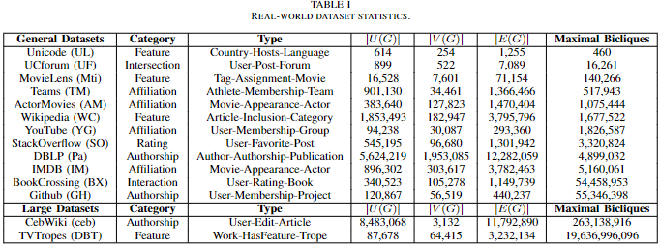
Evaluation: Datasets
Notes:
Here, we present our testing datasets. The general datasets are commonly used by existing algorithms, containing only millions of maximal bicliques. To test the scalability of AdaMBE, we have added two large datasets with billions of maximal bicliques, which current approaches struggle to handle efficiently.

Slide 17
Evaluation: Overall Evaluation
Running time evaluation on general datasets (log scale). Parallel MBE algorithms are indicated by diagonal lines.
Our AdaMBE outperforms all other serial competitors by 1.6x-49.7x across all datasets.
Our parallel ParAdaMBE is 1.3x-33.7x faster than the CPU-based ParMBE on all datasets.
ParAdaMBE on a 96-core CPU is up to 5.07x faster than GMBE on an A100 GPU on time-consuming datasets like StackOverflow, BookCrossing, and GitHub.
Notes:
In the overall evaluation, we assess AdaMBE against state-of-the-art methods using general datasets. For serial MBE algorithms, AdaMBE outperforms its competitors by a factor of 1.6x to 49.7x across all datasets. For parallel MBE algorithms, we compare both CPU-based and GPU-based competitors. Although the GPU-based competitor, GMBE, utilizes thousands of computing cores on an A100 GPU—far more than our CPU-based algorithm ParAdaMBE with 96 cores—ParAdaMBE still demonstrates better performance on time-consuming datasets such as StackOverflow, BookCrossing, and GitHub.

Slide 18
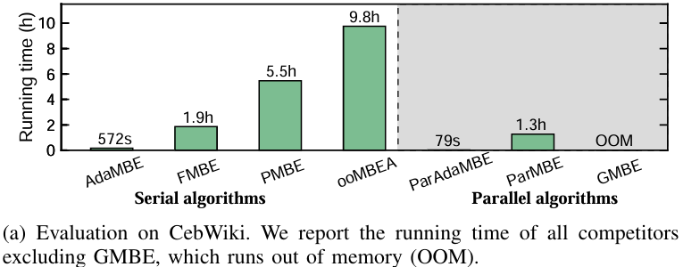
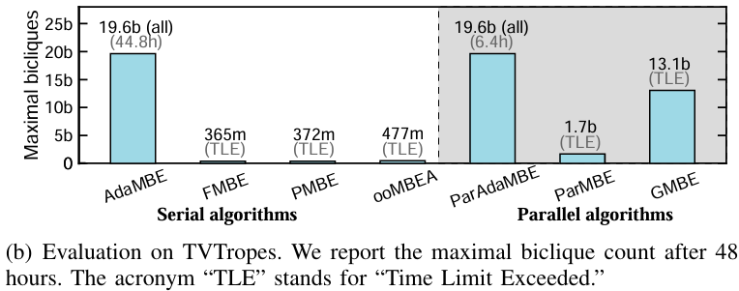
Evaluation: Overall Evaluation
Overall evaluation on two large datasets.
On the CebWiki dataset, AdaMBE and ParMBE complete in 572 and 79 seconds, respectively, while all other competitors take several hours.
On the TVTropes dataset, only AdaMBE and ParMBE can enumerate all 19.6 billion maximal bicliques within 48 hours.
Notes:
Furthermore, our new algorithm enables the exploration of larger datasets that are challenging for existing algorithms. Specifically, On the CebWiki dataset, AdaMBE and ParAdaMBE complete in 572 and 79 seconds, respectively, while all other competitors take several hours. On the TVTropes dataset, only AdaMBE and ParAdaMBE can enumerate all 19.6 billion maximal bicliques within 48 hours. For the other algorithms that did not complete the enumeration within 48 hours, we report the number of maximal bicliques they had enumerated by the 48-hour mark. As we can see, many cutting-edge algorithms were unable to even complete 1% of the enumeration.
A major contribution of our work is that it makes it possible to tackle the MBE problem on datasets containing billions of maximal bicliques, significantly expanding the scope of exploration.
Q1: Why do existing GPU-based methods fail on large graphs? A1: On the one hand, as the graph size increases, the memory consumption of GPU methods grows significantly, often leading to "out of memory" issues. On the other hand, even if they run, the performance suffers due to excessive access to irrelevant vertices and the inefficient intersection operations based on adjacency lists, which cause a substantial slowdown.
Q2: What are the challenges in applying your method to GPUs? A2: One challenge is the implementation of subgraph methods based on local neighbor computations, which are difficult to optimize for GPUs. In our experiments, we found that these methods increased memory usage, which is not a major issue on CPUs but becomes critical on GPUs. This is because massive parallel threads require multiple copies of the context. As for subgraph-based methods, we are already experimenting with them and have seen promising results. Feel free to contact me privately if you're interested.

Slide 19
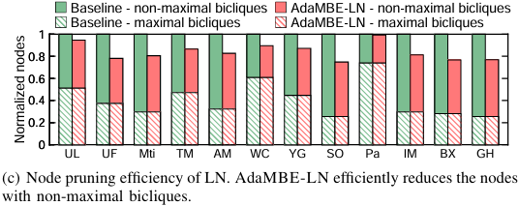
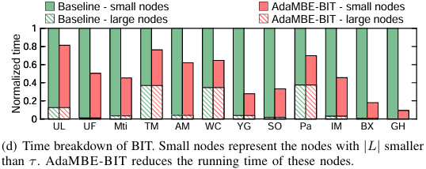
Evaluation: Breakdown Analysis
Both local-neighbor-based optimizations (LN) and the hybrid in-memory bitmap representation (BIT) enhance AdaMBE's performance.
Notes:
In the breakdown evaluations, we analyze the running time, memory usage, node pruning efficiency, and the time spent on bitmap usage to assess the effectiveness of our proposed local-neighbor-based optimizations and the hybrid in-memory bitmap representation.
The results show that both optimization techniques significantly improve the performance of the baseline, which only disables these methods. When combined, they yield even better results.

Slide 20
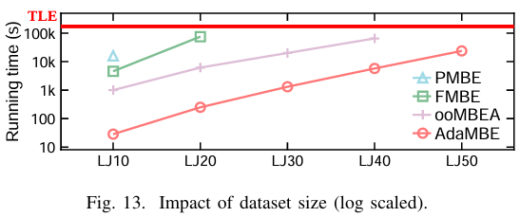
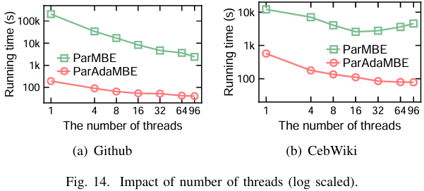
Evaluation: Sensitivity Analysis
AdaMBE excels over all serial competitors on large synthetic datasets with billions of maximal bicliques.
ParAdaMBE consistently outperforms ParMBE across all thread configurations.
Notes:
Finally, we conducted several sensitivity analyses, presenting two key examples. For scalability, we generated large synthetic datasets containing billions of maximal bicliques. AdaMBE outperforms all serial competitors. Note that GPU-based approaches are not included in this figure, as they consistently encounter out-of-memory issues on such large datasets.
Note that although AdaMBE is designed to run on CPUs, it can also be extended to a GPU implementation. We leave the exploration of AdaMBE on GPUs for future work. Additionally, ParAdaMBE consistently outperforms ParMBE across all thread configurations.

Slide 21
Enumeration of Billions of Maximal Bicliques in Bipartite Graphs without Using GPUs
Open source
https://github.com/ISCS-ZJU/AdaMBE
Contact information
Zhe Pan: panzhe@zju.edu.cn
Notes:
That’s all. Thank you for your listening. Any questions?
Q1: Why do existing GPU-based methods fail on large graphs? A1: On the one hand, as the graph size increases, the memory consumption of GPU methods grows significantly, often leading to "out of memory" issues. On the other hand, even if they run, the performance suffers due to excessive access to irrelevant vertices and the inefficient intersection operations based on adjacency lists, which cause a substantial slowdown.
Q2: What are the challenges in applying your method to GPUs? A2: One challenge is the implementation of subgraph methods based on local neighbor computations, which are difficult to optimize for GPUs. In our experiments, we found that these methods increased memory usage, which is not a major issue on CPUs but becomes critical on GPUs. This is because massive parallel threads require multiple copies of the context. As for subgraph-based methods, we are already experimenting with them and have seen promising results. Feel free to contact me privately if you're interested.

